Slide 1
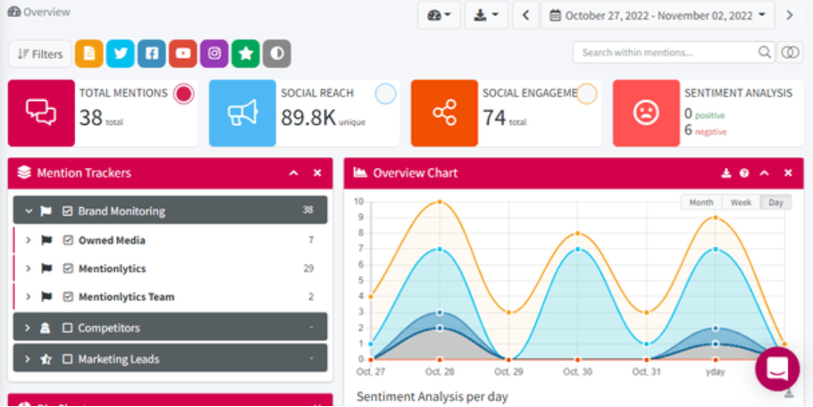
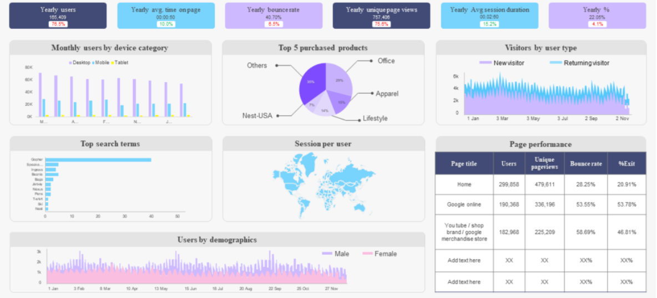
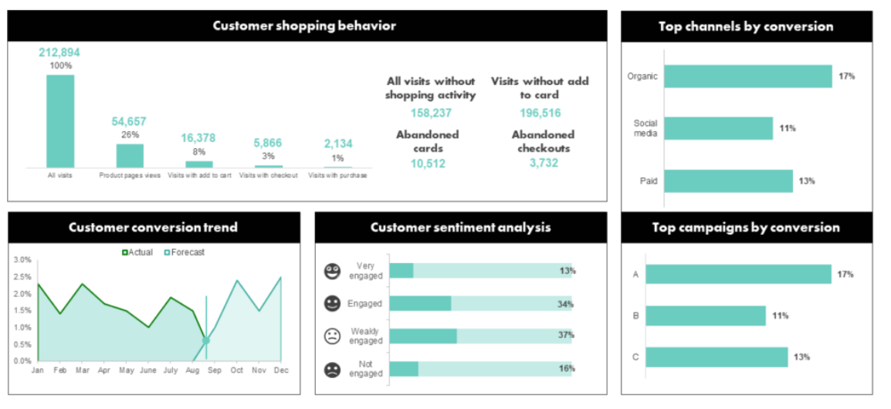
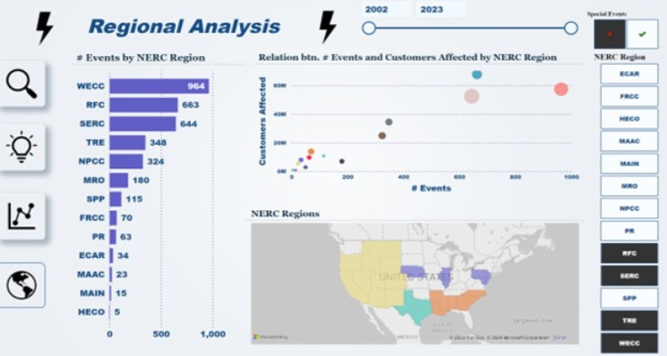
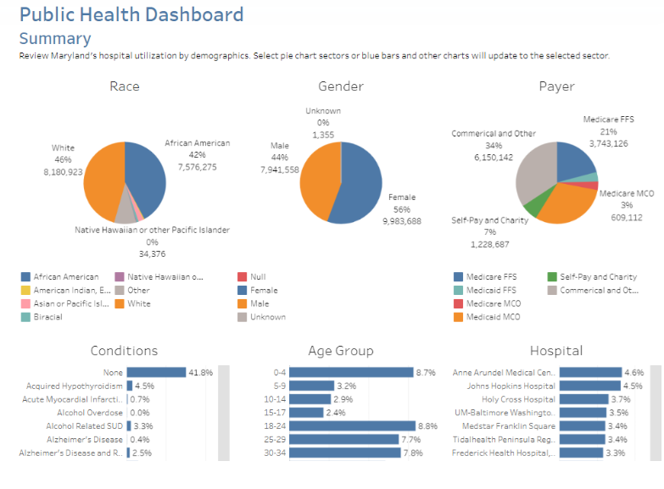
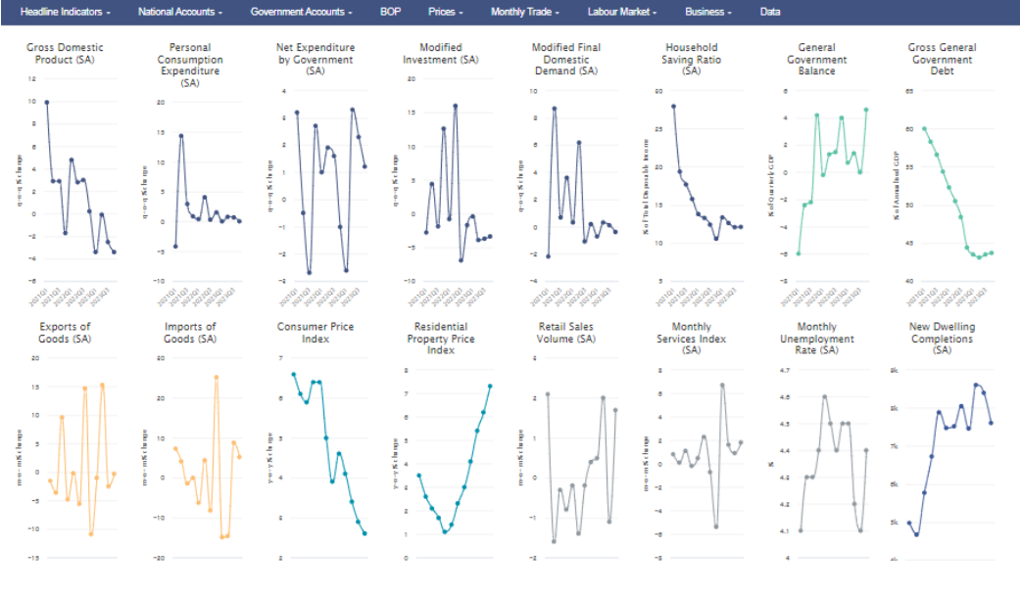
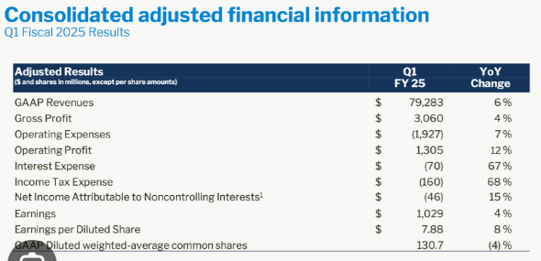
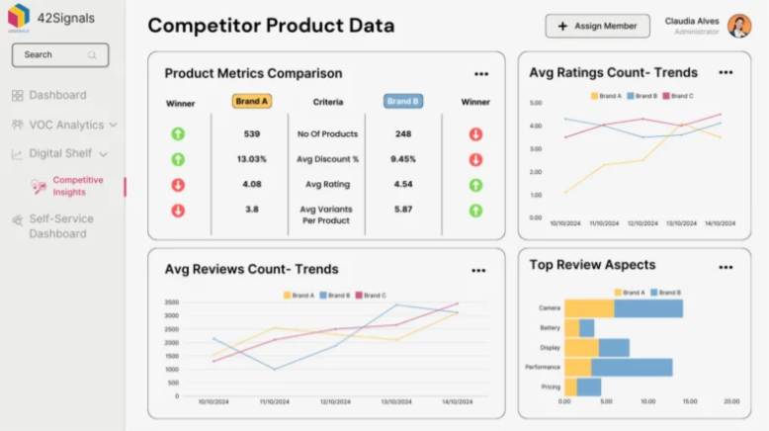
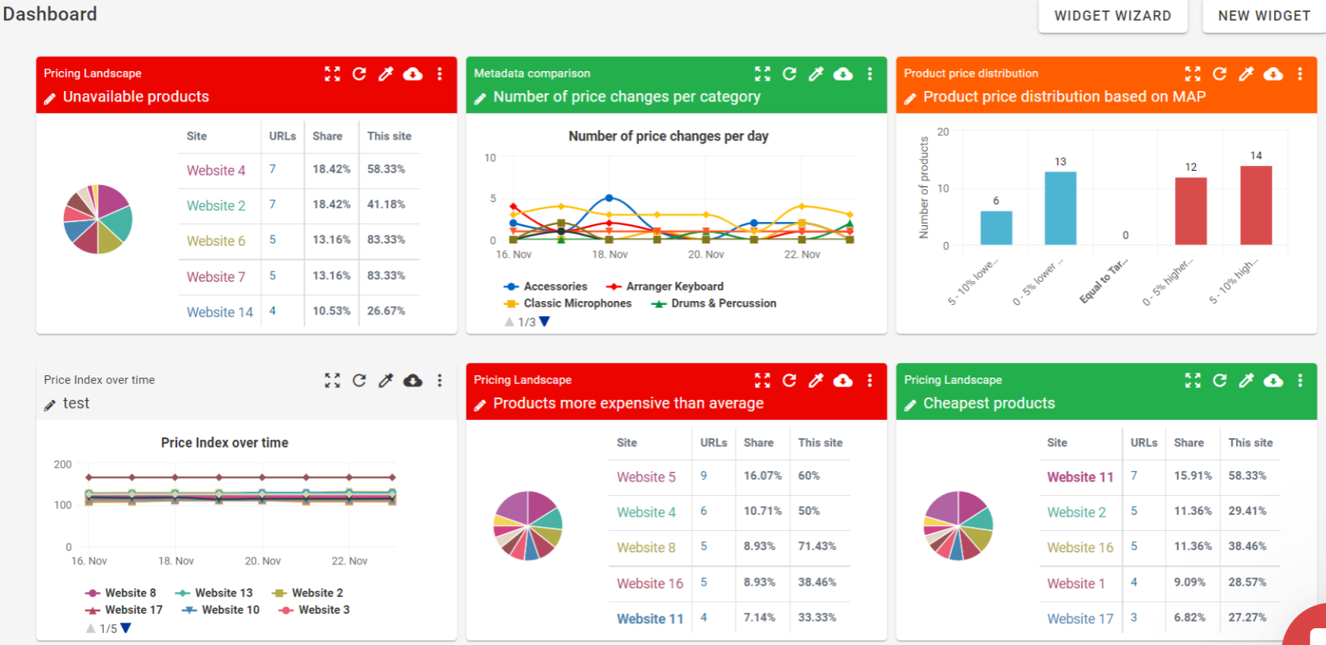
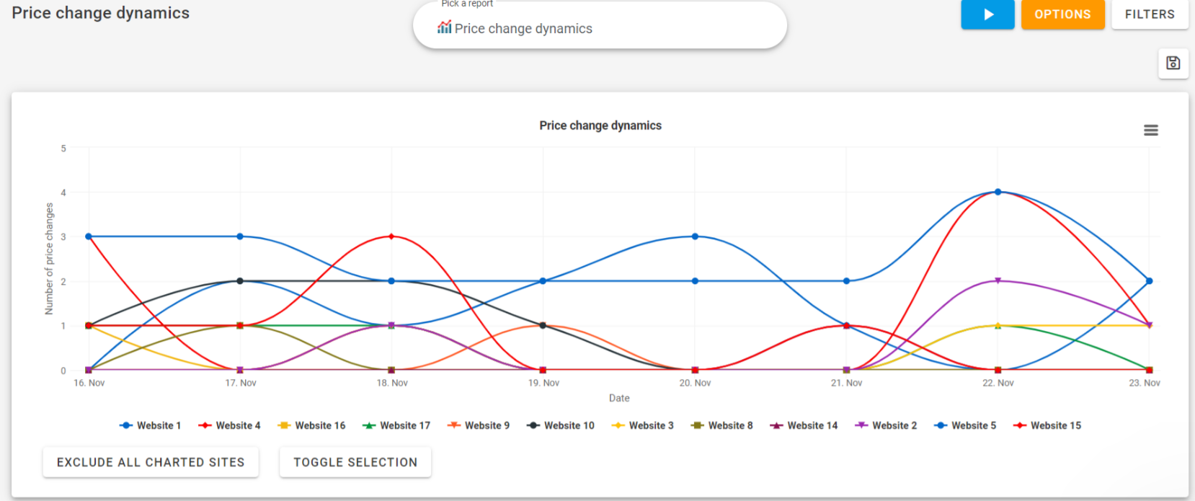
Social Media Monitoring
Market Trends
Agent 9
Agent 1
Agent 8
Consumer Behavior
Weather & Natural Disaster
Agent 2
Healthcare Utilization & Pub Health
Agent 3
Market Intelligence Agent
Microeconomics & Industry News,
CPI, Spending ,FDA news
Agent 6
Agent 4
Competitor Economic Reports
Competitor Tracking
Agent 7
Pricing Intelligence
Agent 5

